Slide 1
US East Climatology Setup
24 August 2014

Slide 2
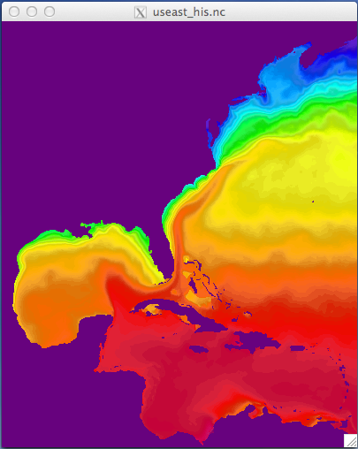
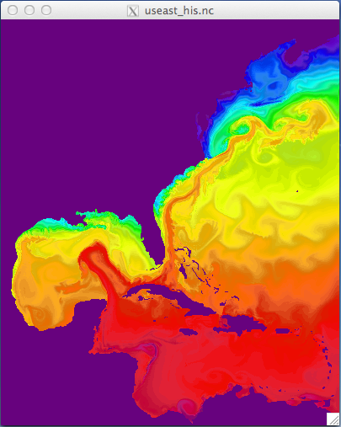
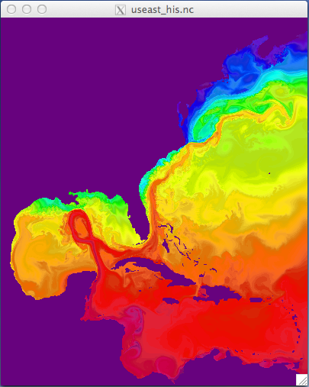
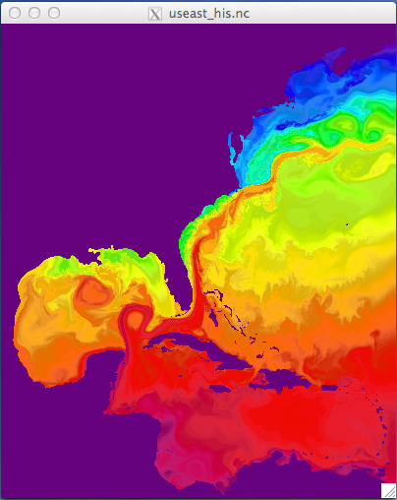
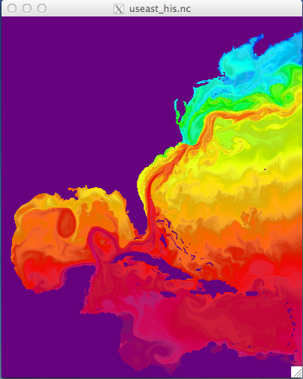
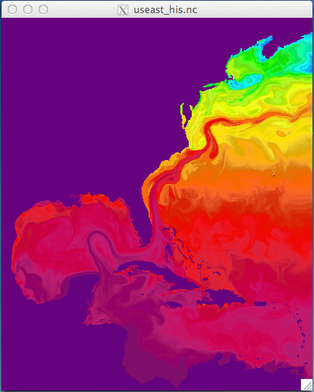
Jan 01
Feb 01
Mar 01
temp
temp
temp
Apr 01
May 01
Jun 01
temp
temp
temp

Slide 3
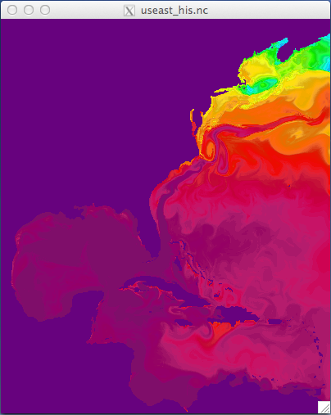
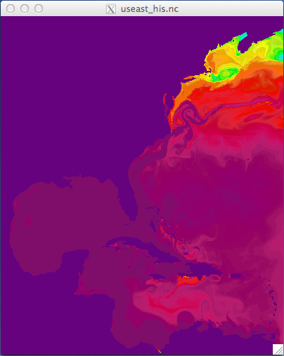
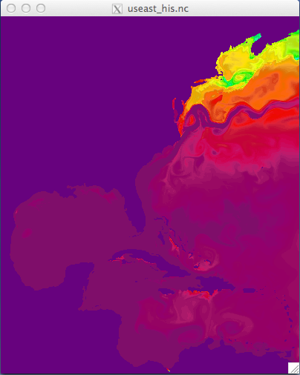
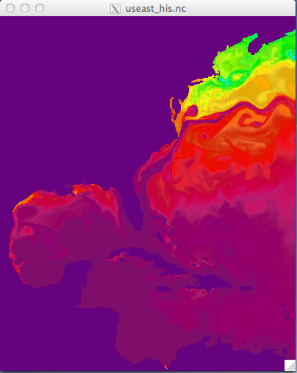
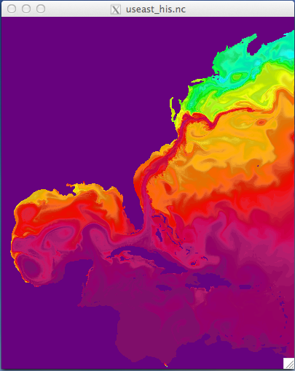
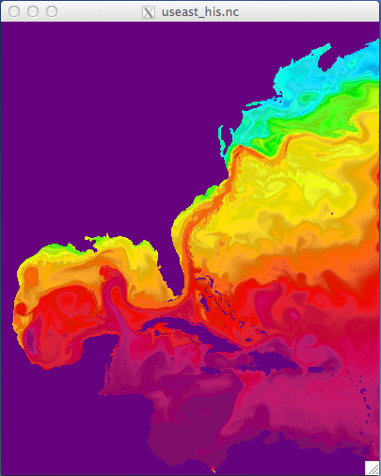
Jul 01
Aug 01
Sep01
temp
temp
temp
Oct 01
Nov 01
Dec 01
temp
temp
temp

Slide 4
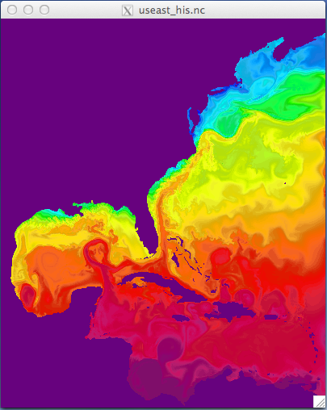
Year 1 : January 2
Year 2 : January 1

Slide 5
Conclusions
Boundary Conditions look much better
No recirculation, smooth transition
Gulf Stream is not as strong as previous simulations
Able to exit domain, energy leaves
Possibly a bit more unstable
Strange features near the GS deflection point
Eddy formation, strong cold water bulge

Slide 6
What’s next?
Run simulation for a second year to assess if the strange GS deflection associated with the bulge of cold water is due to the adjustment to surface forcing.

